Slide 1
Title Page
Topic: Handbook
Name: “PLACES”
Team: RC
Developer: Ossipov Artem (28266)

Slide 2
Project description
the idea of my project is to view all the sights of Kazakhstan and be able to book tickets to visit these places.

Slide 3
Project relevance
I think this is a very interesting project, because in Kazakhstan there is no platform where you can not only explore all the sights of the country, but also immediately select a ticket and date for a trip to them.

Slide 4
Responsibility of team members
I am the only member of the team. In this project I am engaged in the implementation of this idea, development of HTML, СSS, work with Bootstrap and JavaScript. At the moment the project is not finished and has only two pages – home page and places page.

Slide 5
Project Features
User can see and explore all sights in our country.
User can see all trips and dates of these sightseeing.
User can choose and purchase tickets for trips of interest.
Administrator be able to add information to the site, create new trips, and edit existing ones.

Slide 6
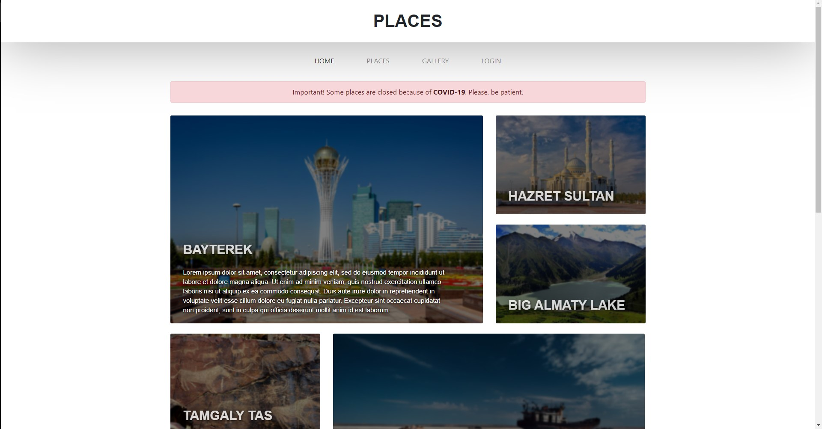
Project Demonstration (home page)

Slide 7
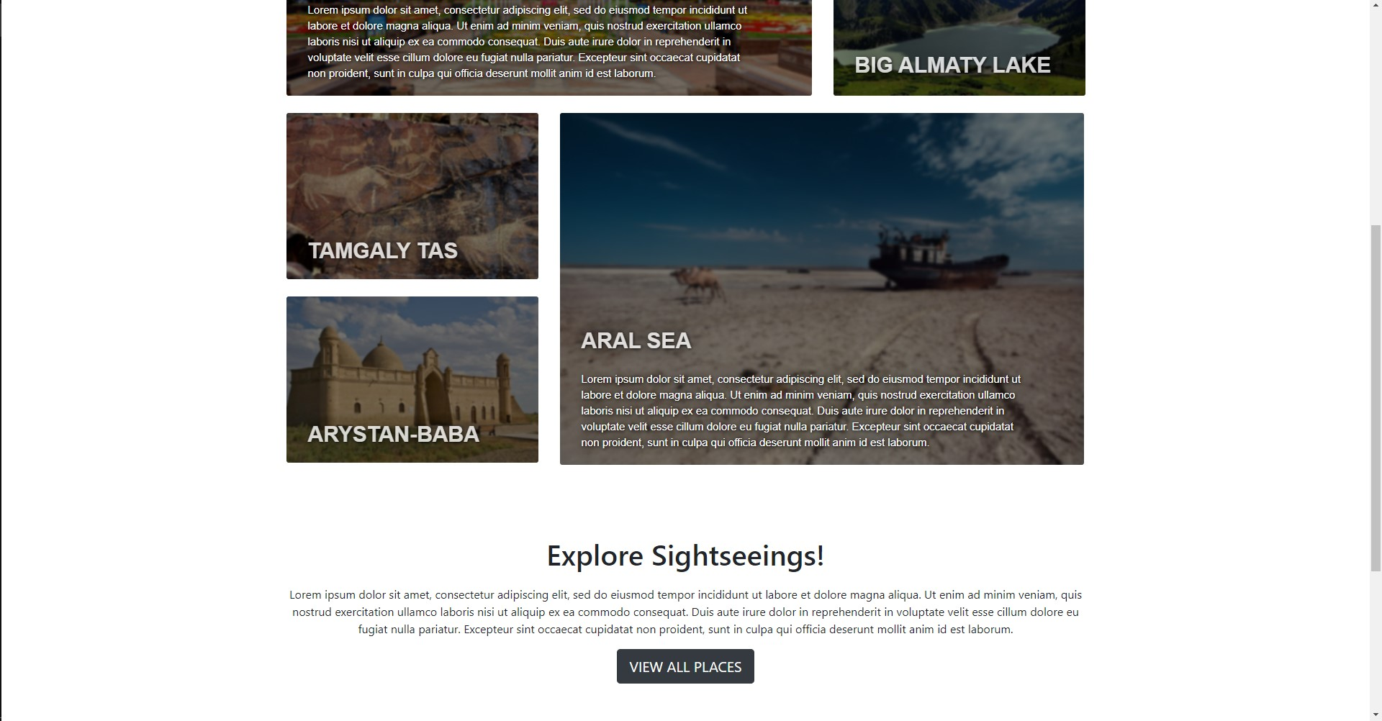
Project Demonstration (home page)

Slide 8
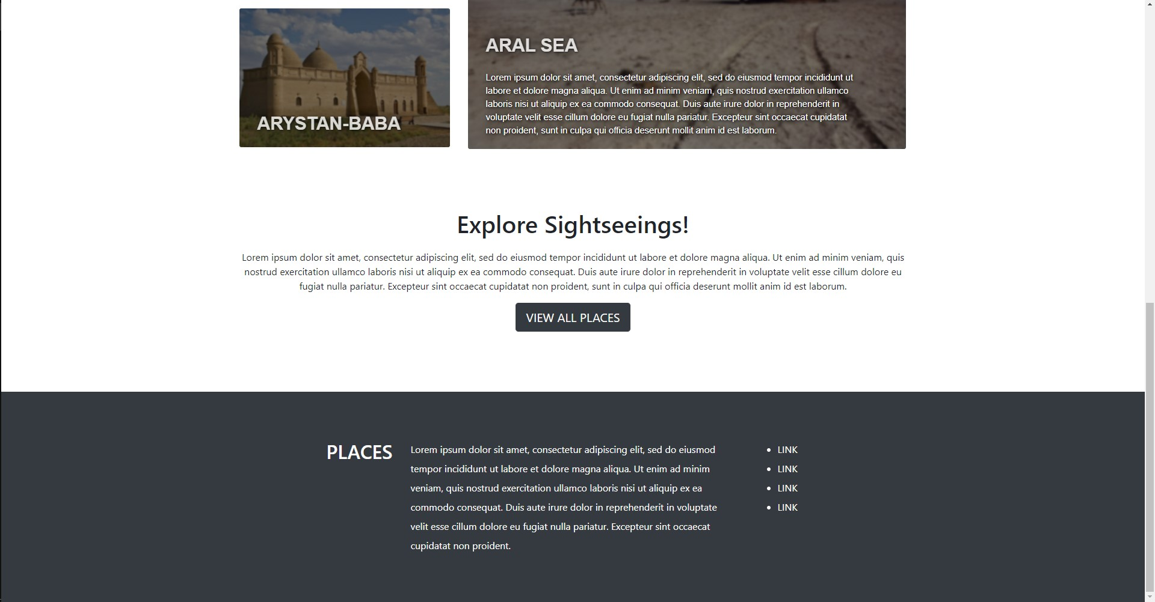
Project Demonstration (home page)

Slide 9
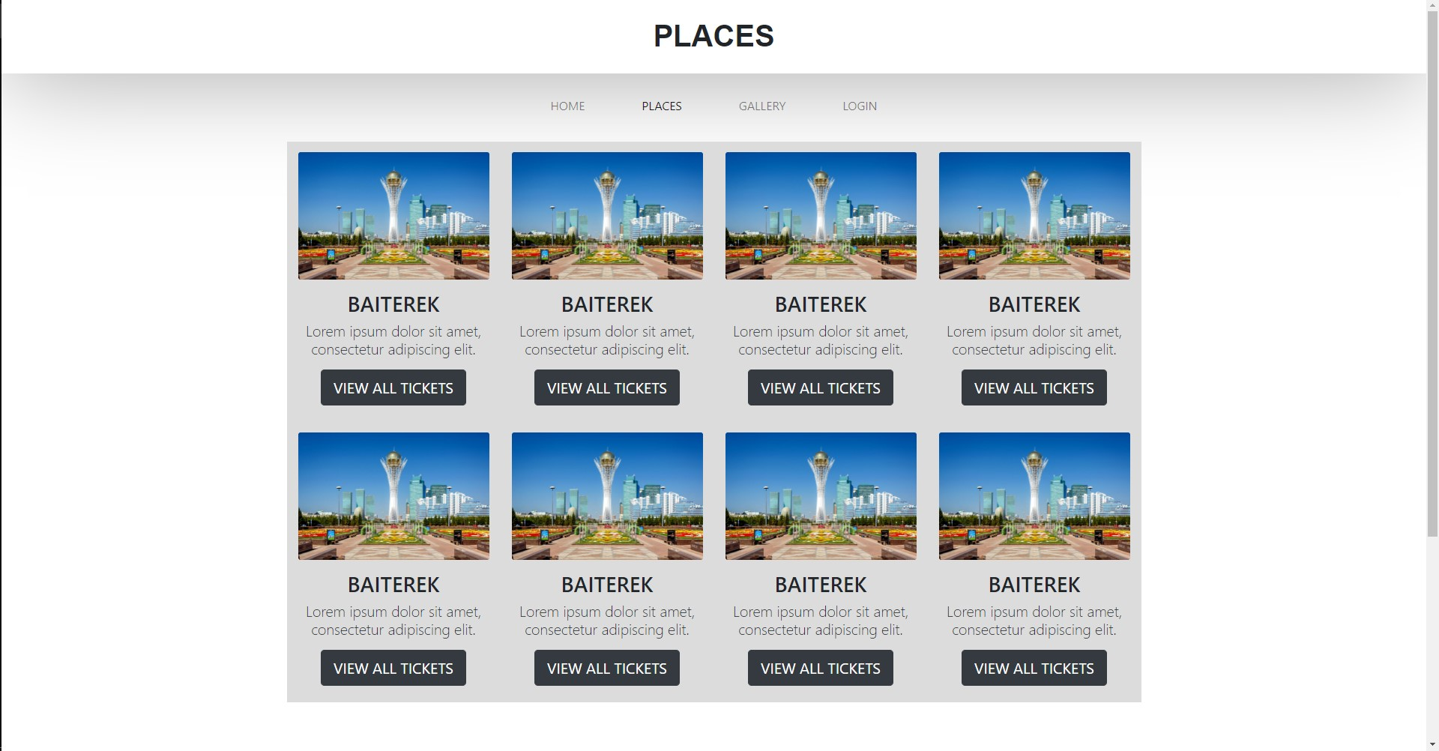
Project Demonstration (places page)

